Slide 1
Proj-Menza-9C
bemutatása

Slide 2
Tartalom
01
02
03
Téma bemutatása
Alkalmazott technológiák
Kígyós Játék
04
05
06
Ebéd Játék
Quiz
Github

Slide 3



Technnológiák
04
05
06
Github
HTML
Tiled

Slide 4



Technnológiák
01
02
03
Javascript
Bootstrap
CSS

Slide 5
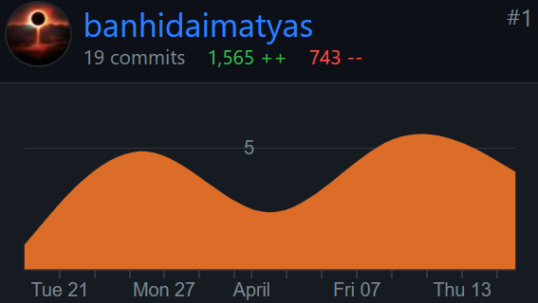
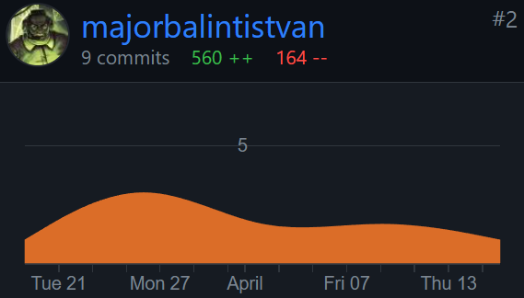
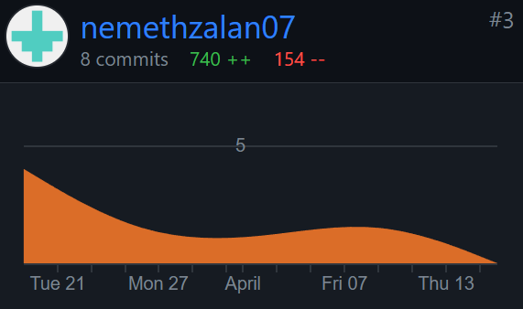
Munkamegosztás
Add a main point
Add a main point
Add a main point

Slide 6
Köszönjük a figyelmet!
Készítette: Németh Zalán, Bánhidai Mátyás, Major Bálint

Slide 7
How to Use This Presentation
Google Slides
PowerPoint
Canva
Click on the "Google Slides" button below this presentation preview.
Click on "Make a copy."
Start editing your presentation.
You need to sign in to your Google account.
Click on the "PowerPoint" button below this presentation preview.
Start editing your presentation.
Download and install the fonts used in this presentation as listed on the next page.
Click on the "Canva" button under this presentation preview.
Start editing your presentation.
You need to sign in to your Canva account.

Slide 8

Announcement
I'm Rain, and I'll be sharing with you my beautiful ideas.
Follow me at @reallygreatsite to learn more.

Slide 9
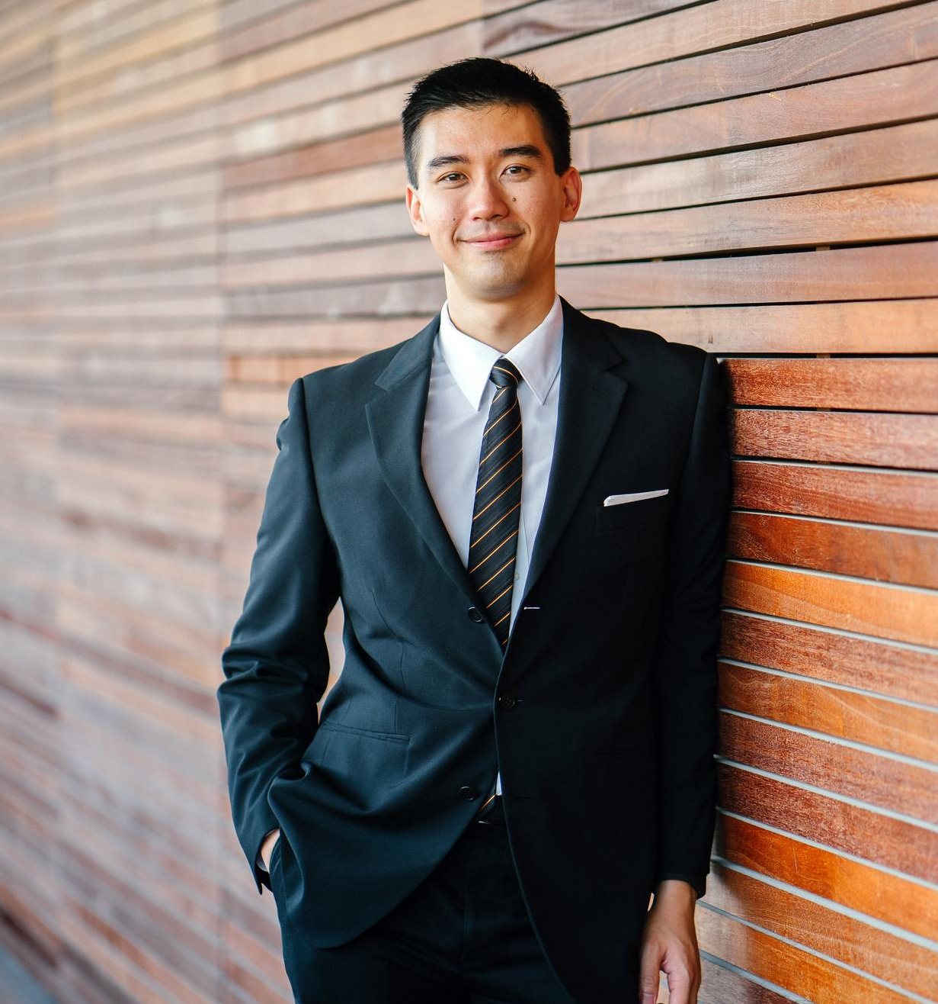
Add an Agenda Page
Write an agenda here.
Write an agenda here.
Write an agenda here.
Write an agenda here.
Write an agenda here.

Slide 10
In dept
Add a main point
Add a main point
Add a main point
Elaborate on a personal detail you want
to share
Elaborate on a personal detail you want
to share
Elaborate on a personal detail you want
to share

Slide 11



Announcements
01
02
03
Amazing announcement for an upcoming event?
Amazing announcement for an upcoming event?
Amazing announcement for an upcoming event?

Slide 12

Big news!

Slide 13
Key features
Add a main point
What do you do during your free time? Write them here!
Add a main point
What do you do during your free time? Write them here!
Add a main point
What do you do during your free time? Write them here!
Add a main point
What do you do during your free time? Write them here!
Add a main point
What do you do during your free time? Write them here!
Add a main point
What do you do during your free time? Write them here!

Slide 14

Big launches
Elaborate your ideas

Slide 15



Awesome launch
What can you say about these new changes?
Share it here!

Slide 16
Write an original statement or inspiring quote
— Include a credit, citation, or supporting message

Slide 17
Write your topic or idea
Add a main point
Add a main point
Add a main point
Elaborate on what you want to discuss.
Elaborate on what you want to discuss.
Elaborate on what you want to discuss.

Slide 18
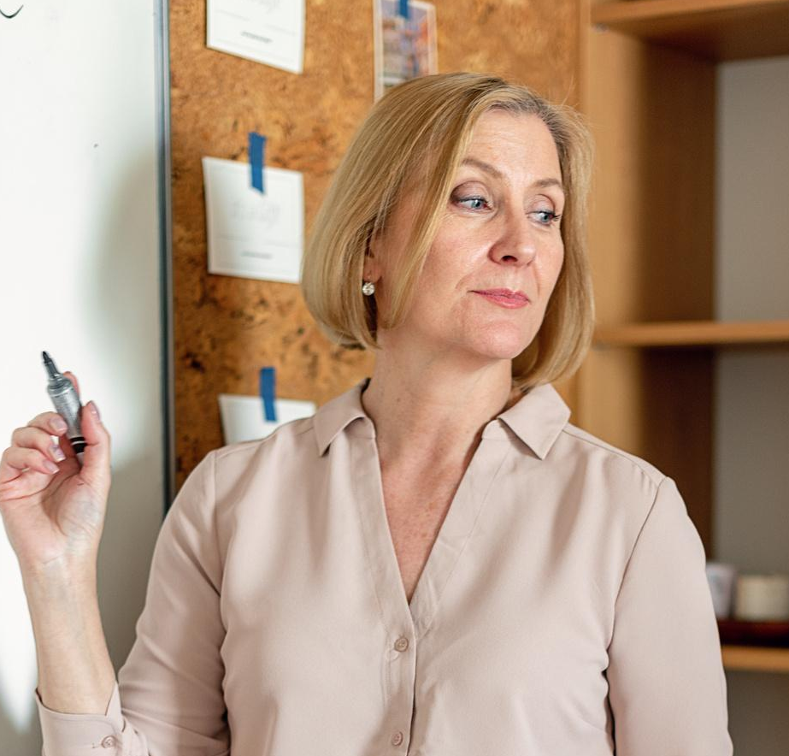


Add a Section Header

Slide 19
2 out
of 5
12
million
95%
Elaborate on the
featured statistic.
Elaborate on the
featured statistic.
Elaborate on the
featured statistic.

Slide 20




Add a Team Member Page
Name
Name
Title or Position
Title or Position
Name
Name
Title or Position
Title or Position

Slide 21
7000,000
Elaborate on the featured statistic

Slide 22
Add a Timeline Page
Add a main point
Add a main point
Elaborate on what you want to discuss.
Elaborate on what you want to discuss.
Add a main point
Add a main point
Elaborate on what you want to discuss.
Elaborate on what you want to discuss.

Slide 23
Add a Roadmap Page
Elaborate on the data you want to discuss
YEAR | JAN | FEB | MAR | APRIL | MAY | JUNE | JULY | AUG | SEPT | OCT | NOV | DEC
Action Point
Action Point
Action Point
Action Point

Slide 24
S
W
STRENGTHS
WEAKNESSES
What are you doing well?
What sets you apart?
What are your good qualities?
Where do you need to improve?
Are resources adequate? What do others
do better than you?
O
T
OPPORTUNITIES
THREATS
What are your goals?
Are demands shifting?
How can it be improved?
What are the blockers you're facing?
What are factors outside
of your control?

Slide 25
Write Your
Topic or Idea
50
40
30
Elaborate on what you want to discuss.
20
10
0
Item 1
Item 2
Item 3
Item 4
Item 5

Slide 26




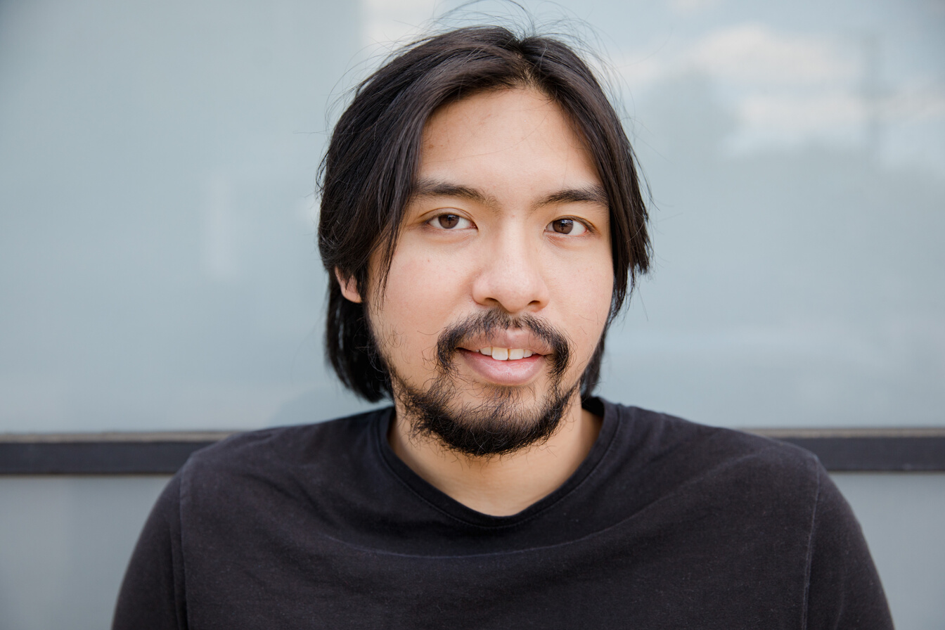


Add a Chart Page
Name
Job Title
Name
Job Title
Name
Job Title
Name
Job Title
Name
Job Title
Name
Job Title
Name
Job Title
Name
Job Title

Slide 27

Credits
This presentation template is free for everyone to use thanks to the following:
SlidesCarnival for the presentation template
Pexels for the photos
Happy designing!

Slide 28

Fonts In this
Presentation
This presentation template
uses the following free fonts:
Titles: Alice
Headers: Open sauce
Body Copy: Open sauce
You can find these fonts
online too.
Happy designing!

Slide 29
Resource
Page
Use these design resources in your Canva Presentation. Happy designing!
Don't forget to delete this page before presenting.

Slide 30
Resource
Page
Use these design resources in your Canva Presentation. Happy designing!
Don't forget to delete this page before presenting.

Slide 31

Free templates for all your presentation needs
For PowerPoint, Google Slides, and Canva
100% free for personal or commercial use
Ready to use, professional, and customizable
Blow your audience away with attractive visuals

